Slide 1


Slide 2


STYLE SPOT
E-COMMERCE WEBSITE

Slide 3

Page 02
FIRST
We would like to thank the Digital Egypt Pioneers Initiative (DEPI), the Ministry of Communications, and the Minister of Communications for empowering us with new skills. We are also grateful to President El Sisi for supporting initiatives that allow us to gain valuable experience. Your guidance is invaluable to our growth and success.

Slide 4

Our e-commerce project aims to be the premier platform for exporting Egyptian clothing internationally, enhancing our nation's exports and boosting foreign currency reserves. By connecting local artisans with global markets, we promote Egypt's rich textile heritage while driving economic growth.
ABOUT
STYLE SPOT
Page 03

Slide 5

OUR
FEASIBILITY STUDY
Budget: Initial investment of $22,000 with monthly operating costs of $3,400; projected annual revenue of $60,000.
Profit Projection: Anticipated first-year profit of $19,200, demonstrating a strong potential for growth and sustainability.
Page 04

Slide 6

TECH STACK
Page 05
HTML/CSS/typeScript: For the basic structure, styling, and interactivity.
Frameworks: Angular for a more dynamic and responsive interface.
CSS Frameworks: Bootstrap for quick styling and responsive design.

Slide 7
Page 06
HEADER
Logo: Prominently displayed at the top left, linking back to the About page.
Navigation Menu: Clear links to the Home, Shop, About Us, and Contact Us pages.
Search Bar: A search input field to allow users to quickly find specific items.
Wishlist: Showing the favourites.
Cart Icon: A shopping cart icon showing the number of items in the cart, leading to the cart page upon clicking and the checkout page as well.
User Account Icon: Options for logging in and registering or accessing user accounts.

Slide 8
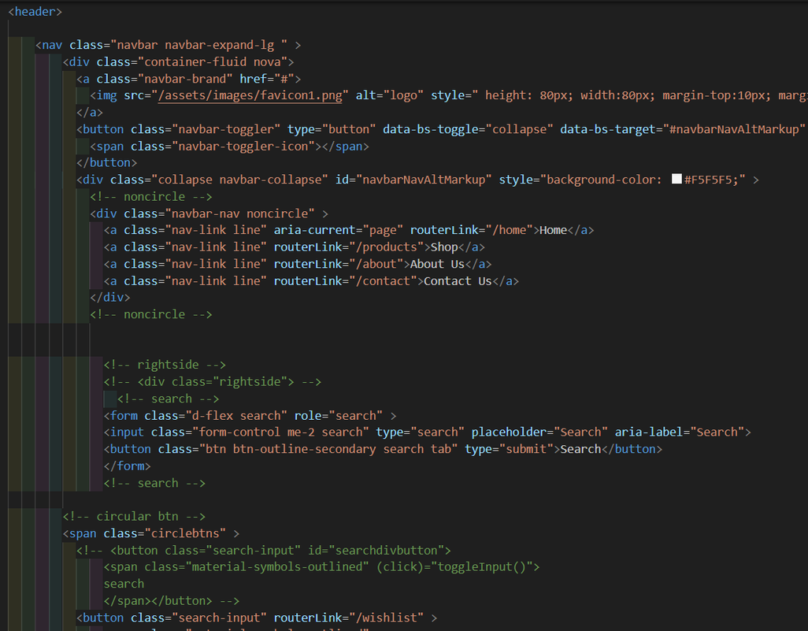
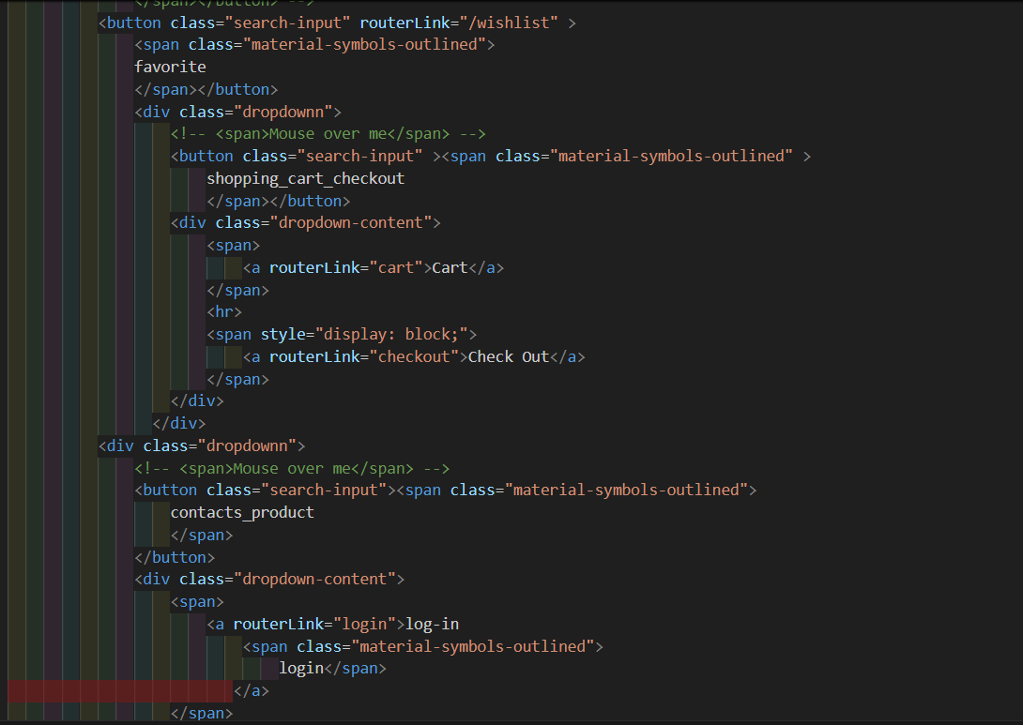
CODE
Page 07

Slide 9
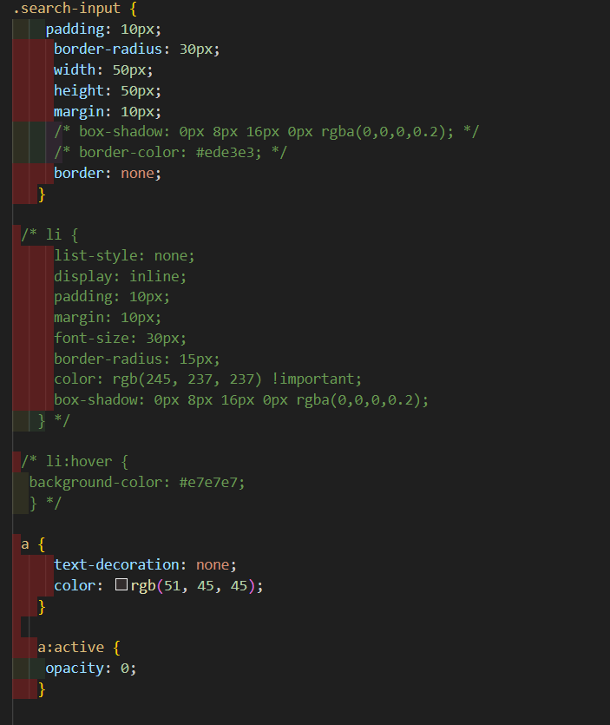
CODE
Page 08

Slide 10
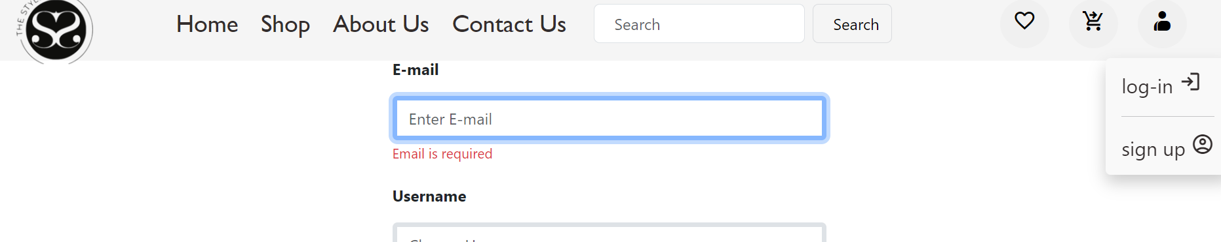
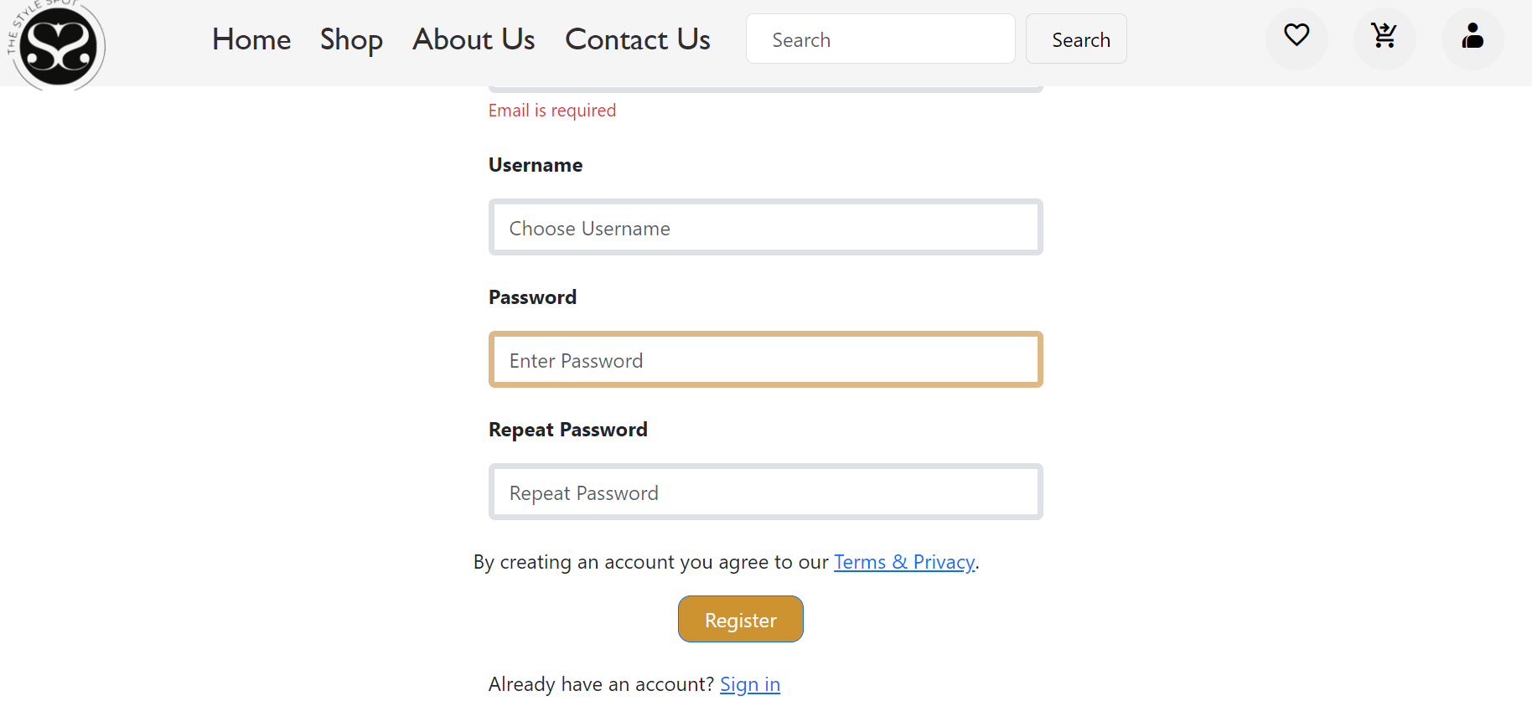
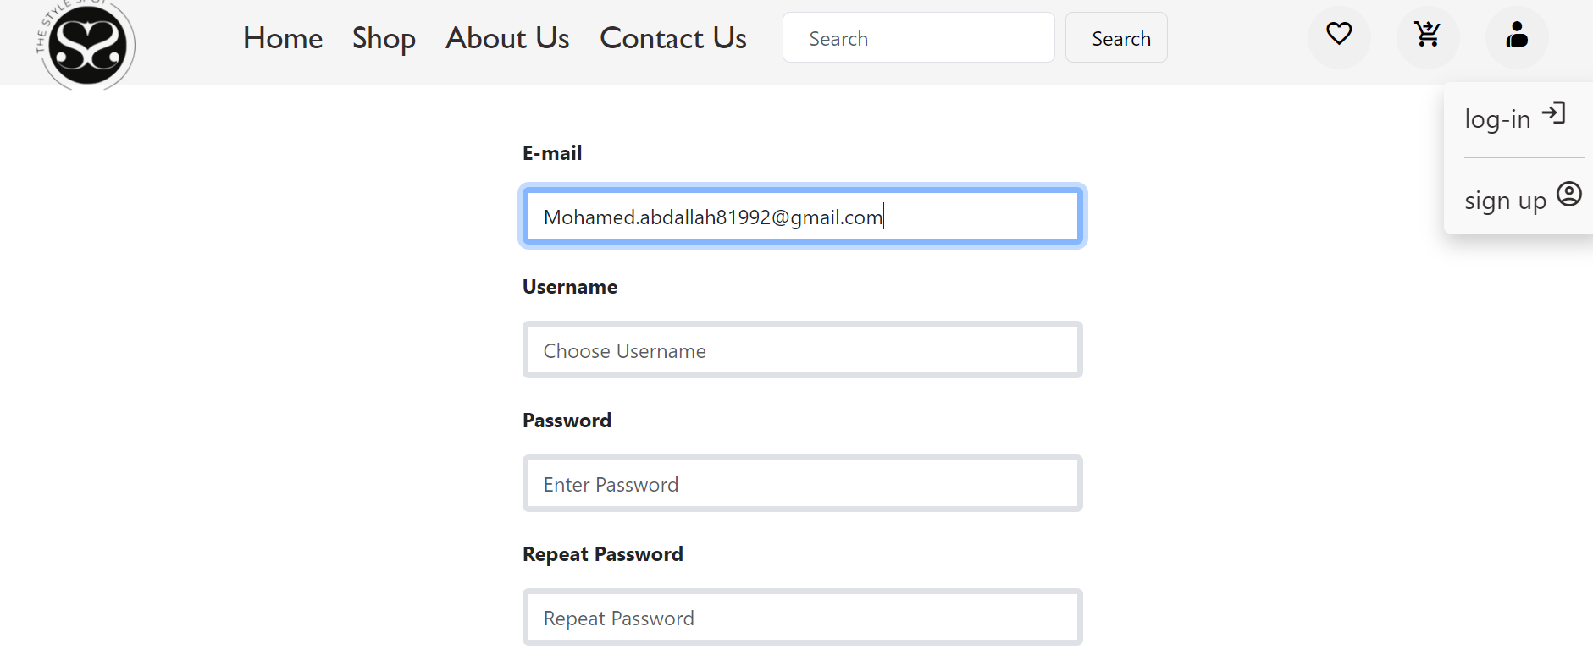
REGISTER
User Authentication: It allow users to create accounts and securely log in, ensuring that their personal information and purchase history are protected.

Slide 11
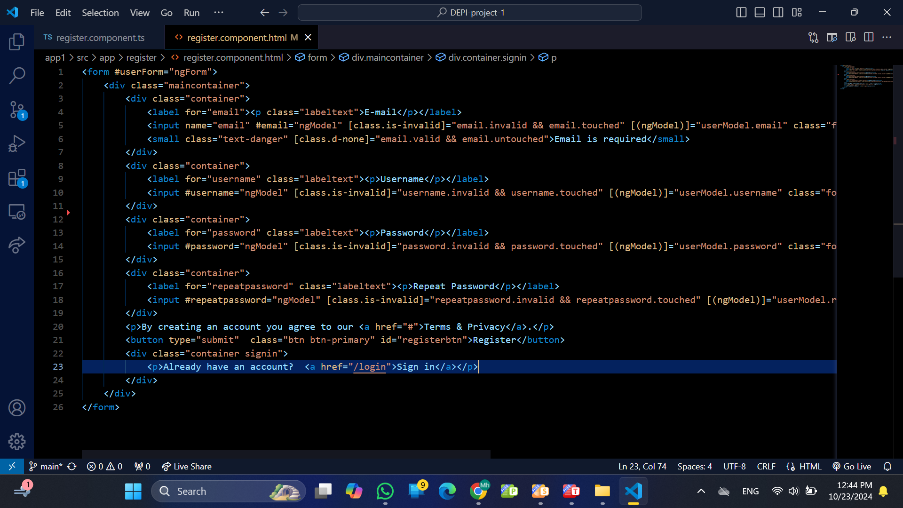
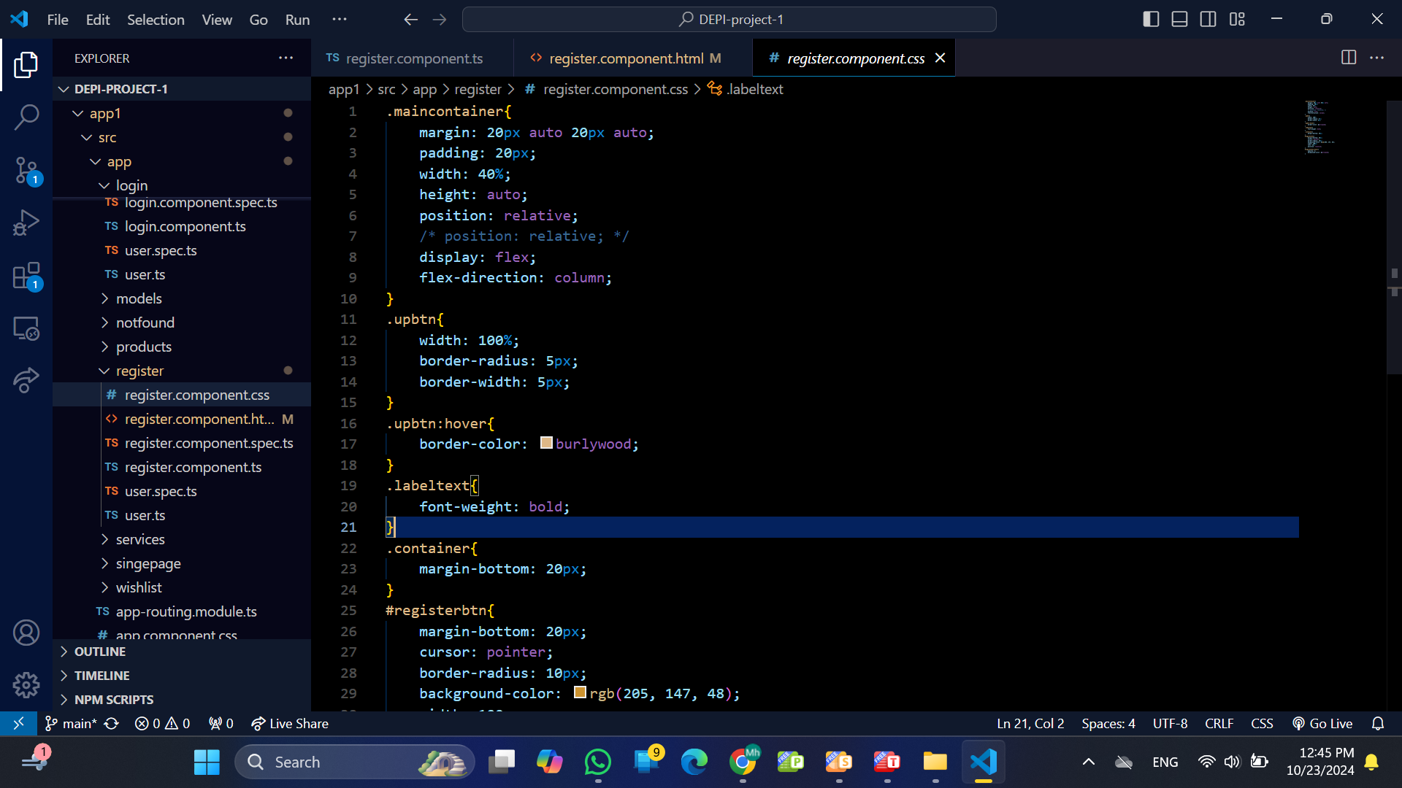
The Code

Slide 12
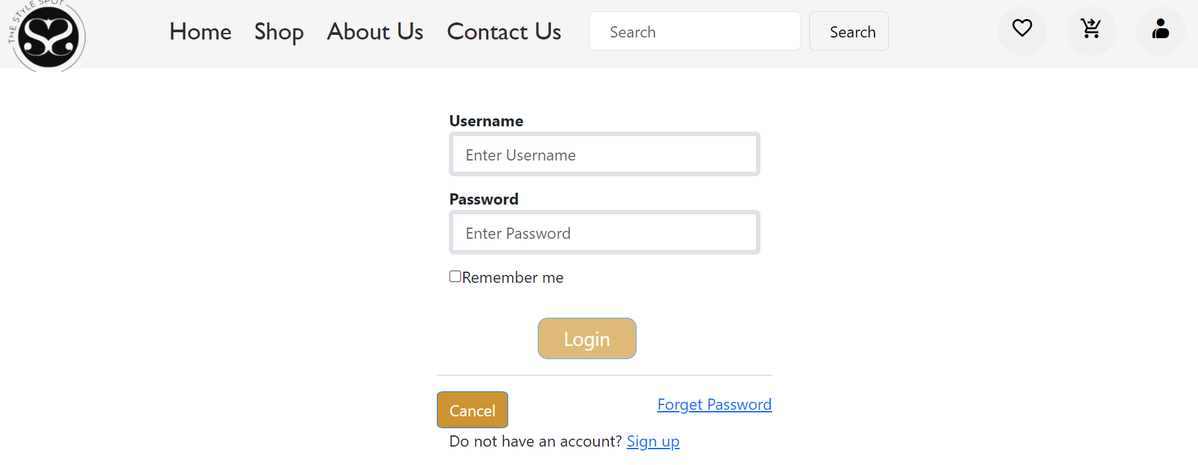
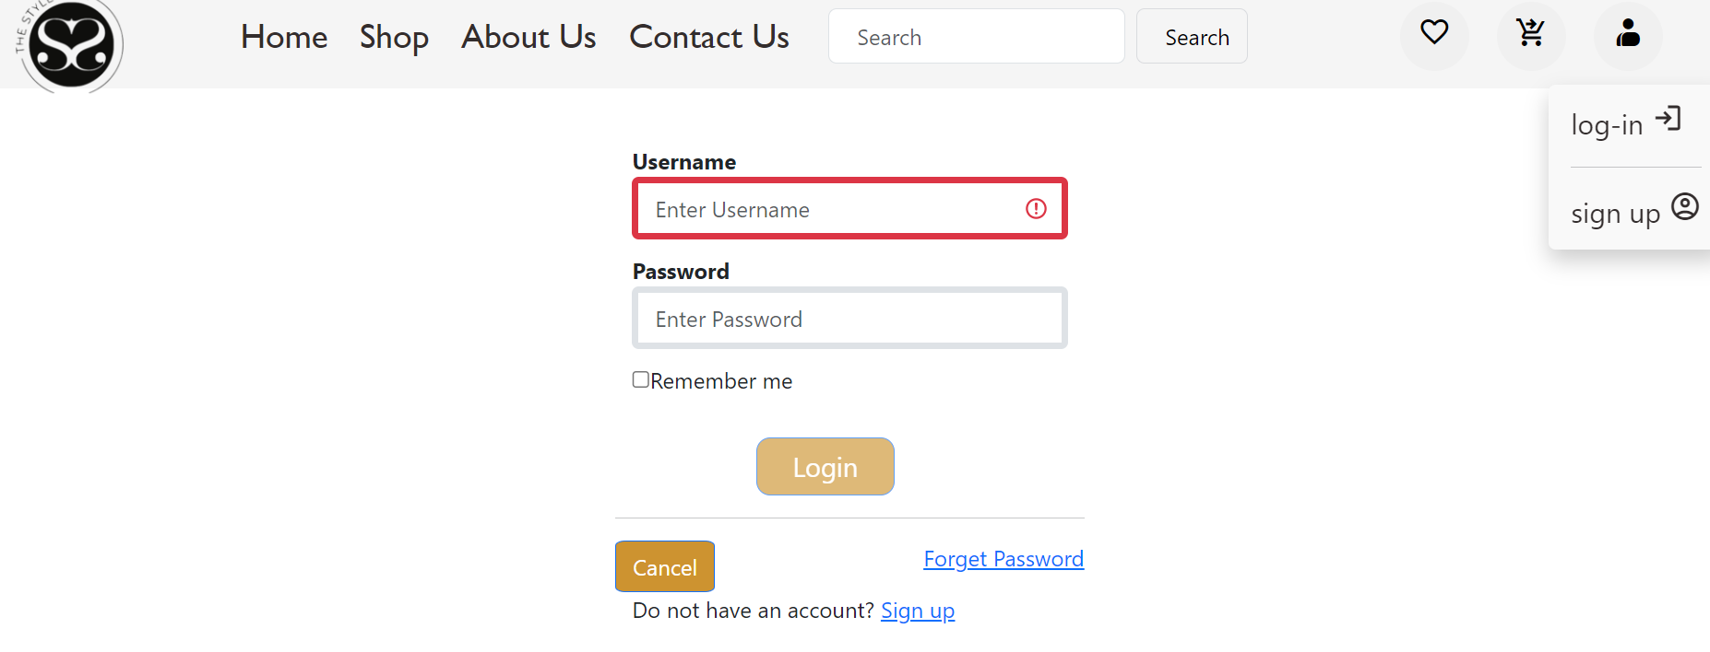
LOGIN
Personalization: Once logged in, users can enjoy a personalized shopping experience, including tailored product recommendations and saved preferences.

Slide 13
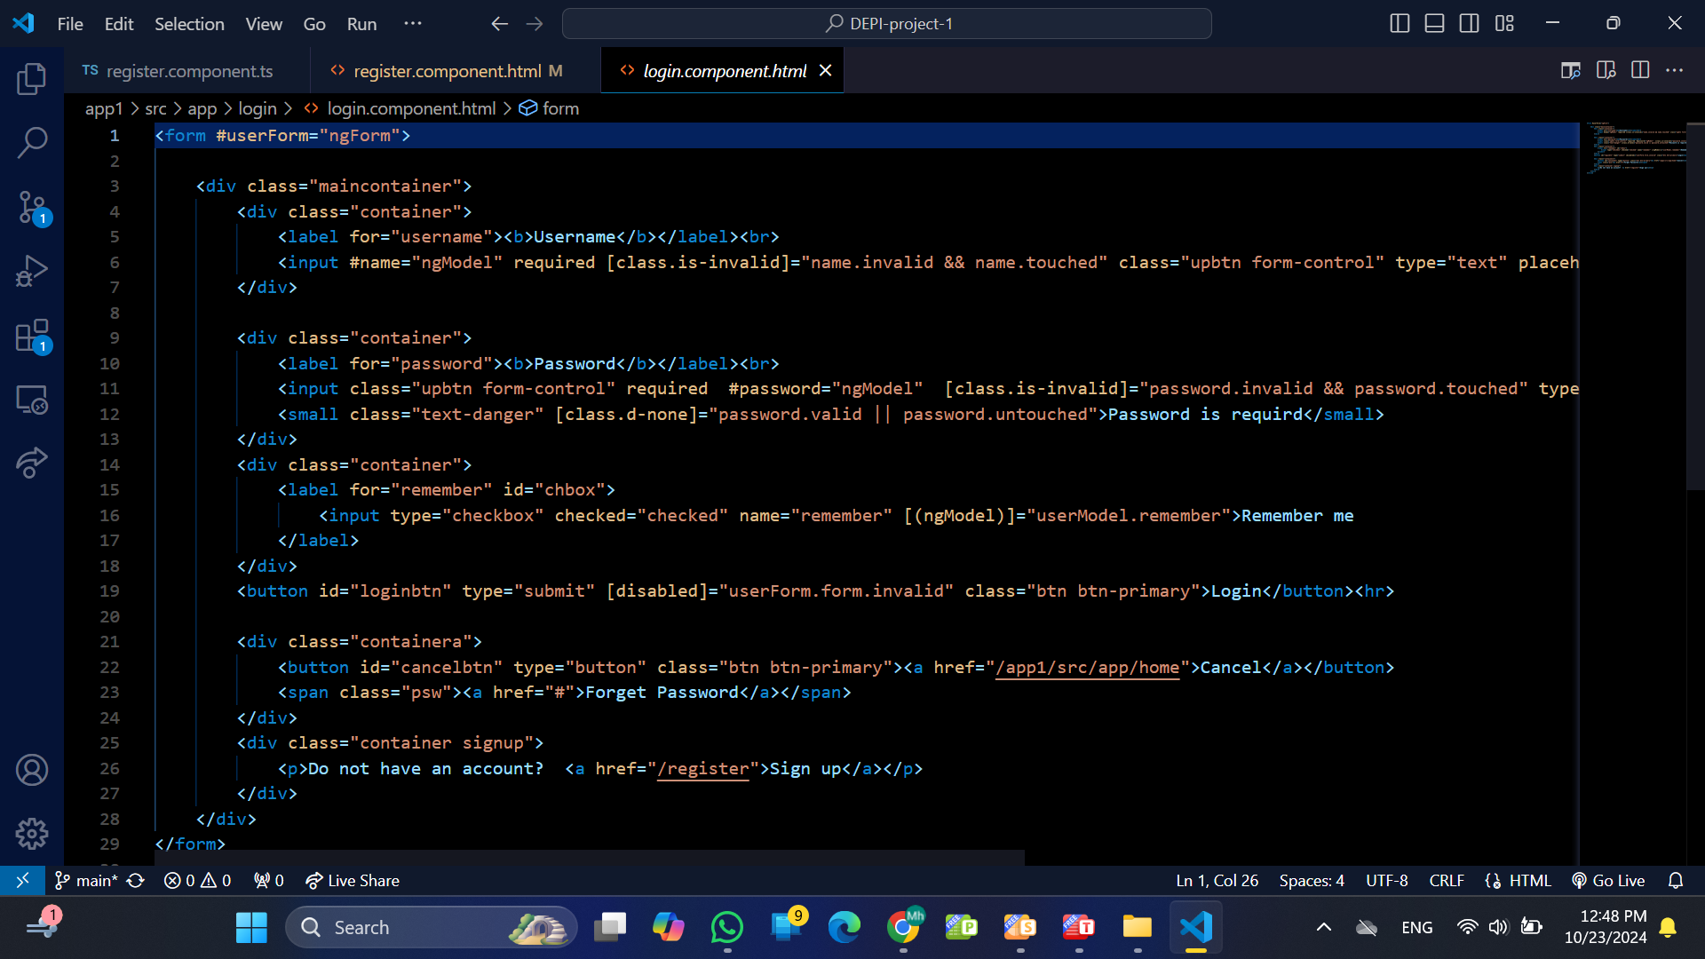
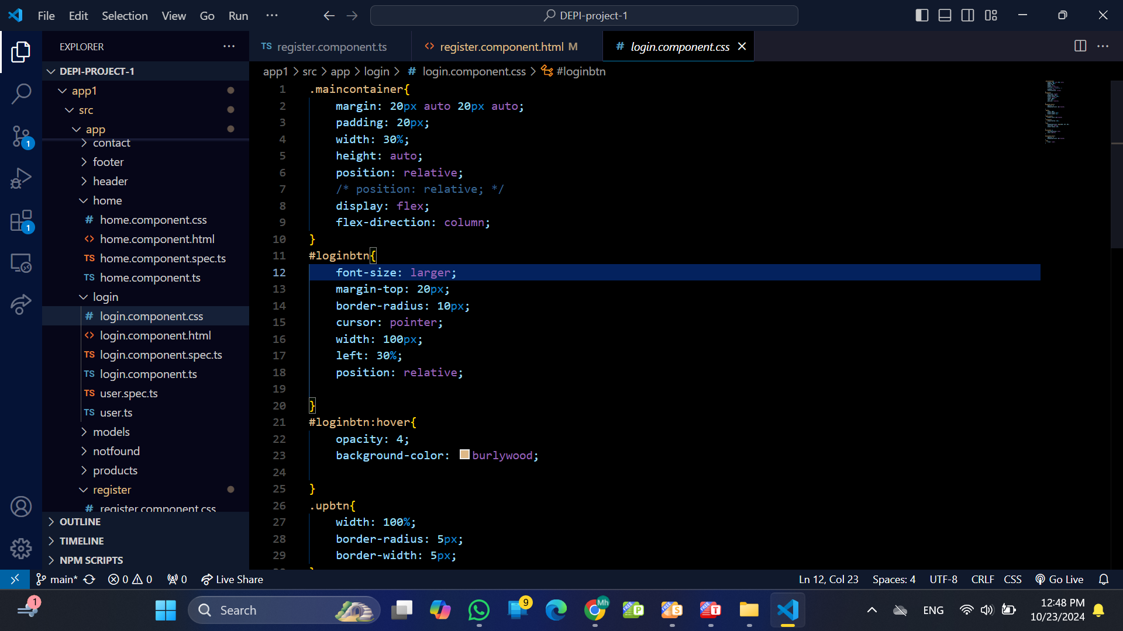
The Code

Slide 14
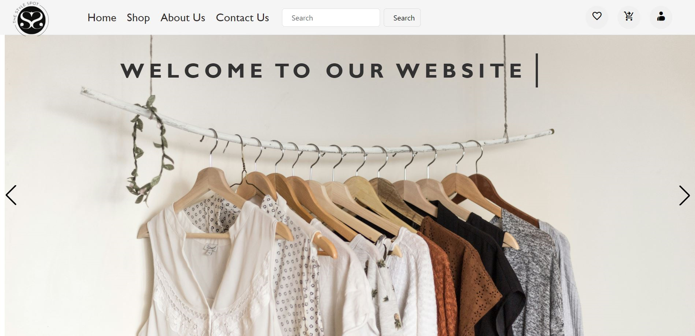
Page 09
Hero Section: A large banner showcasing seasonal promotions or featured collections, with high-quality images.
HOME PAGE

Slide 15
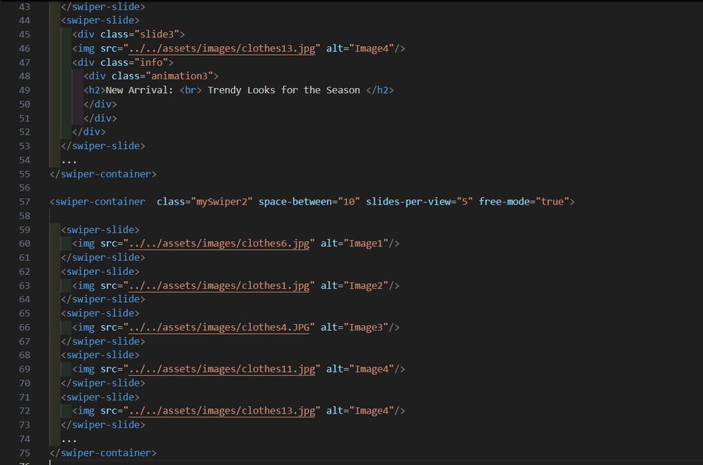
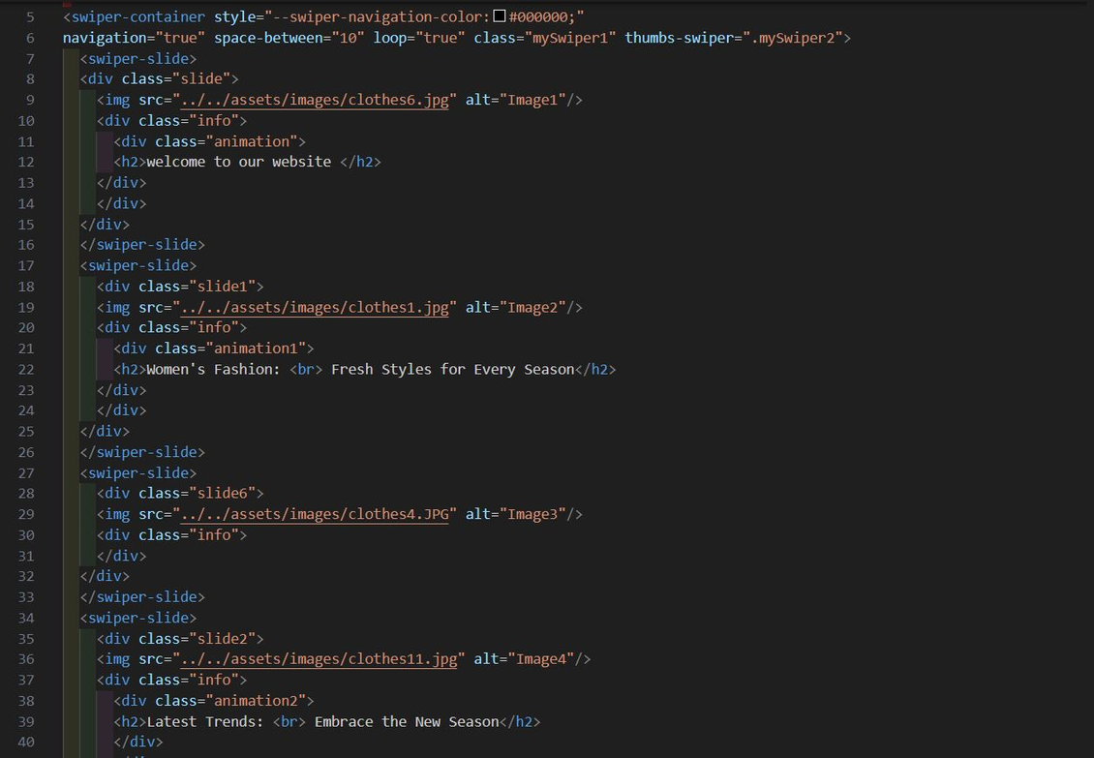
CODE
Page 10

Slide 16
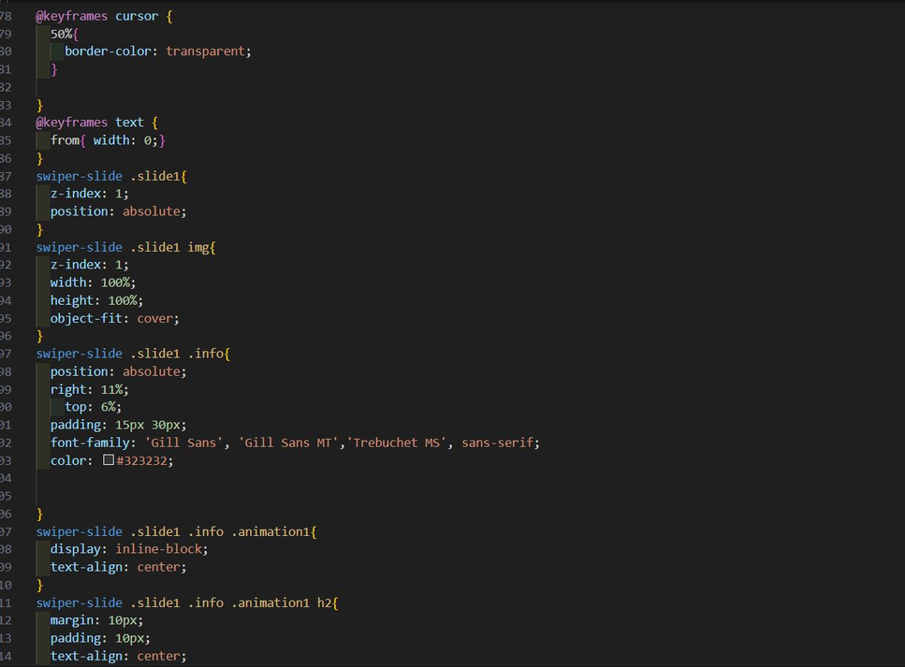
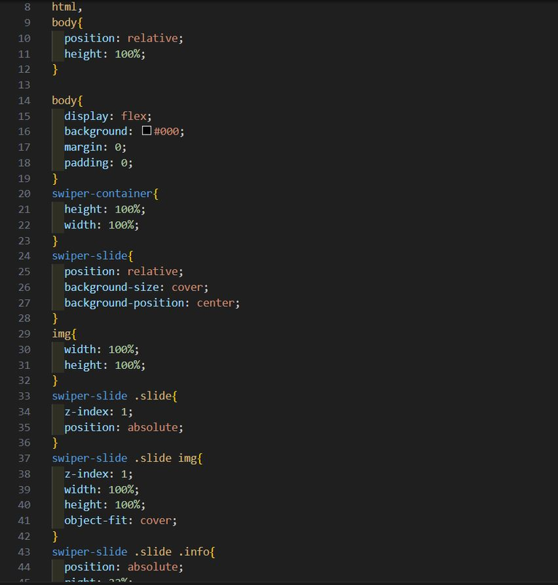
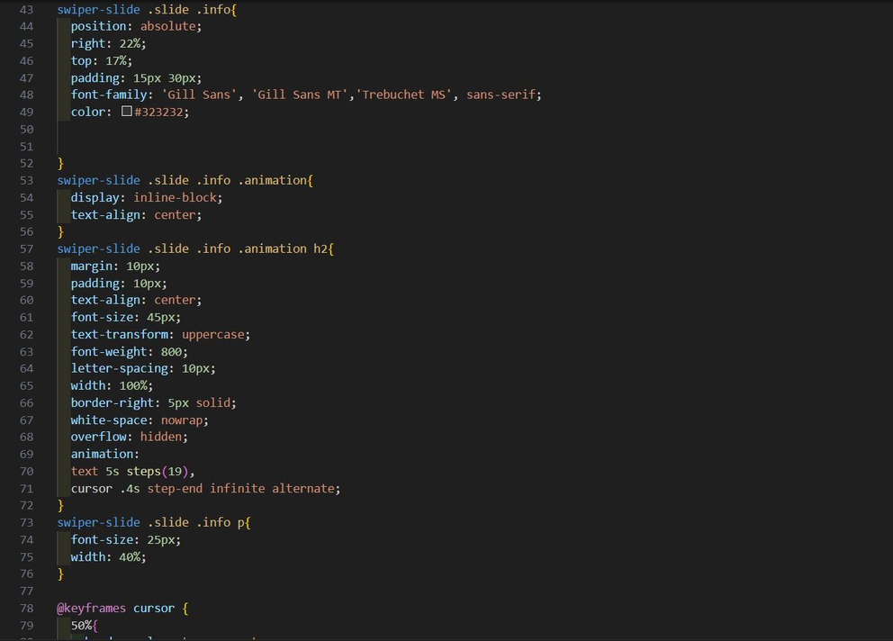
CODE
Page 11

Slide 17
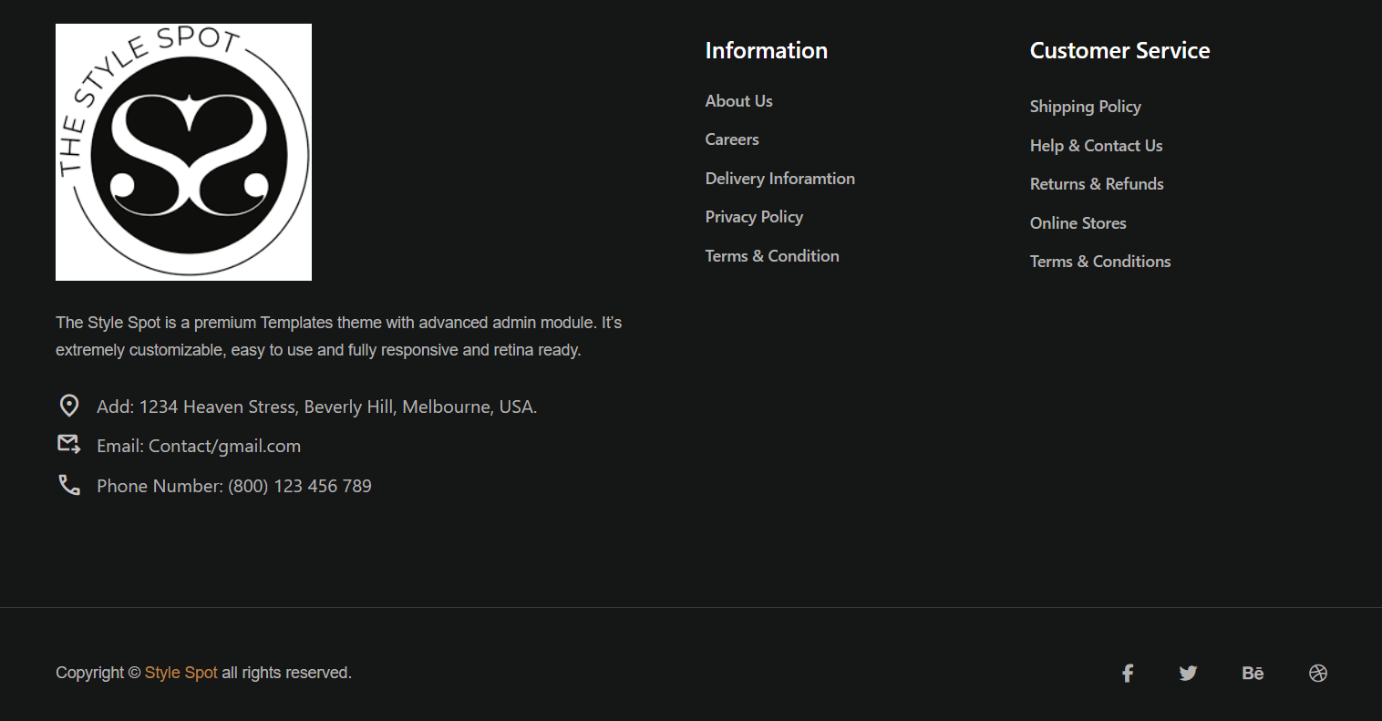
FOOTER
Quick Links: Navigation to important pages like About Us, Privacy Policy, Terms of Service, and Return Policy.
Social Media Icons: Links to social media platforms for further engagement.
Contact Information: Repeated contact details for easy access.
Page 12

Slide 18
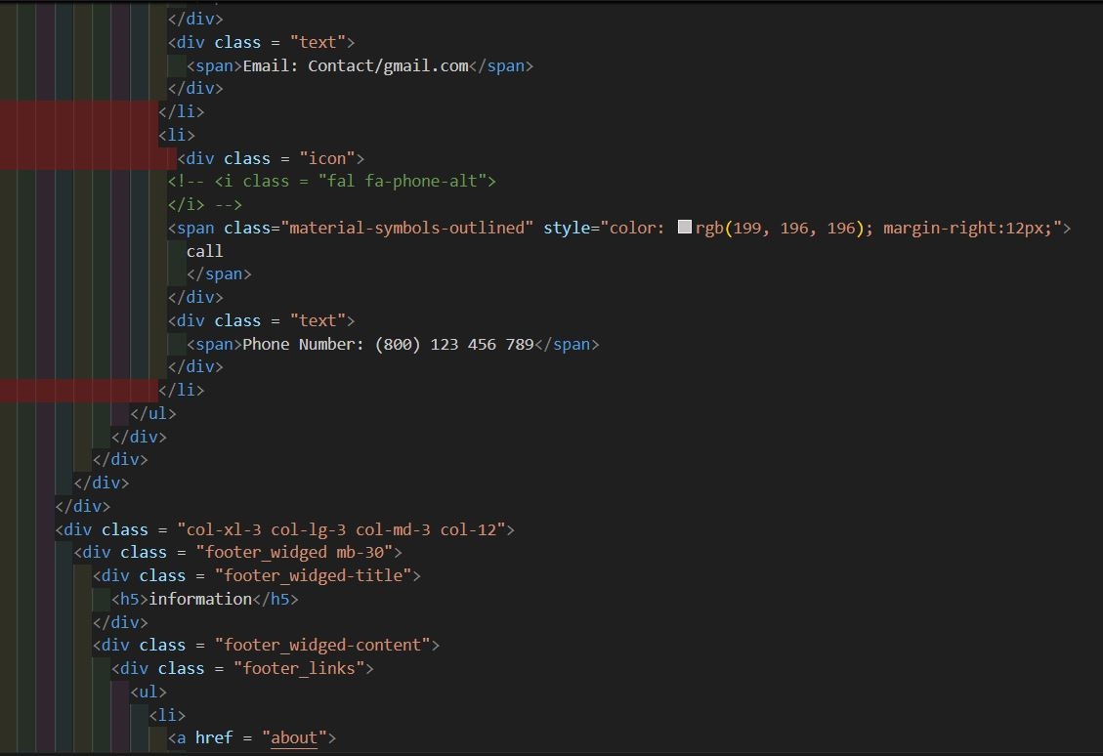
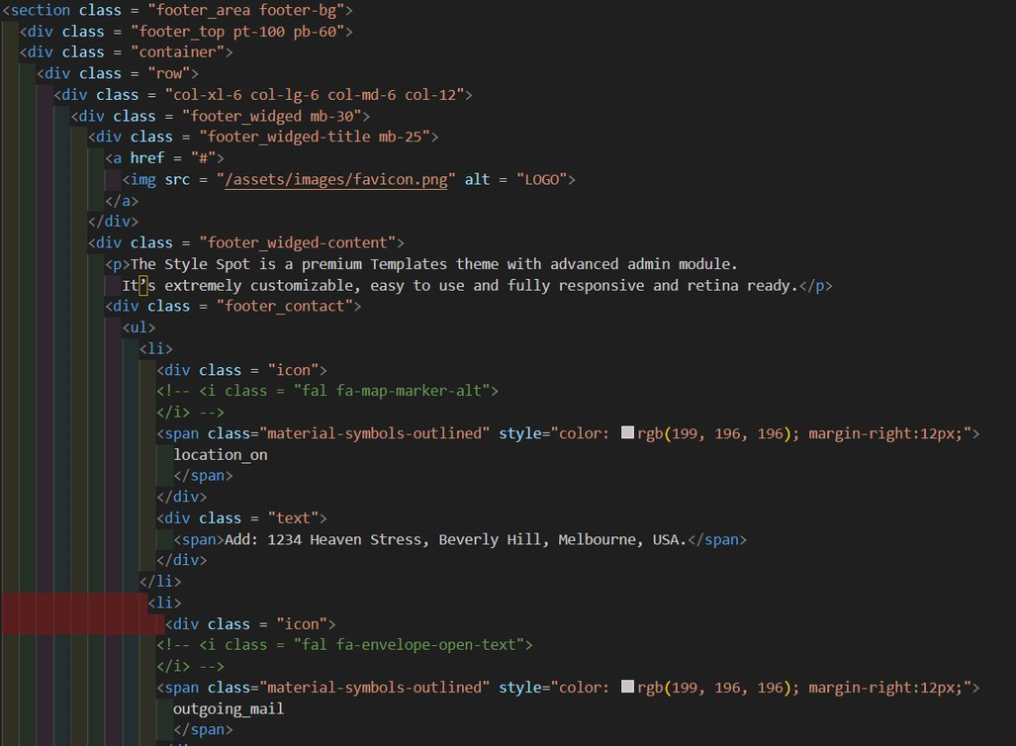
CODE
Page 13

Slide 19
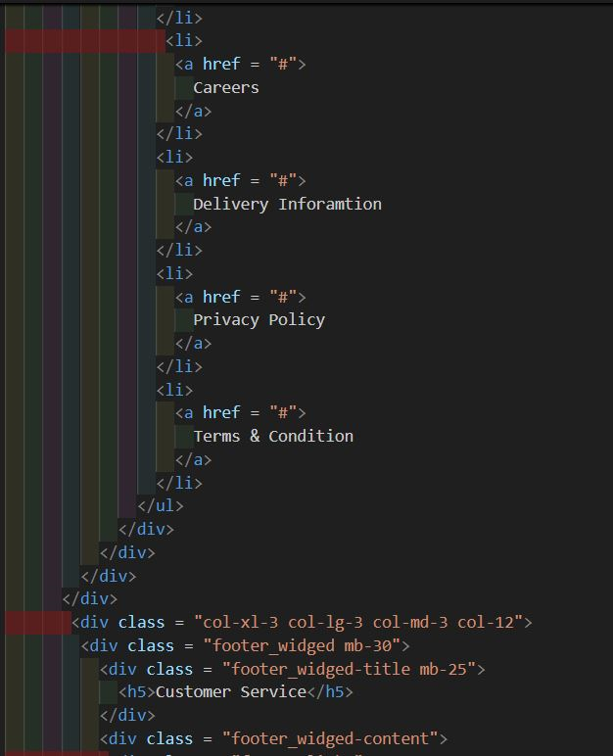
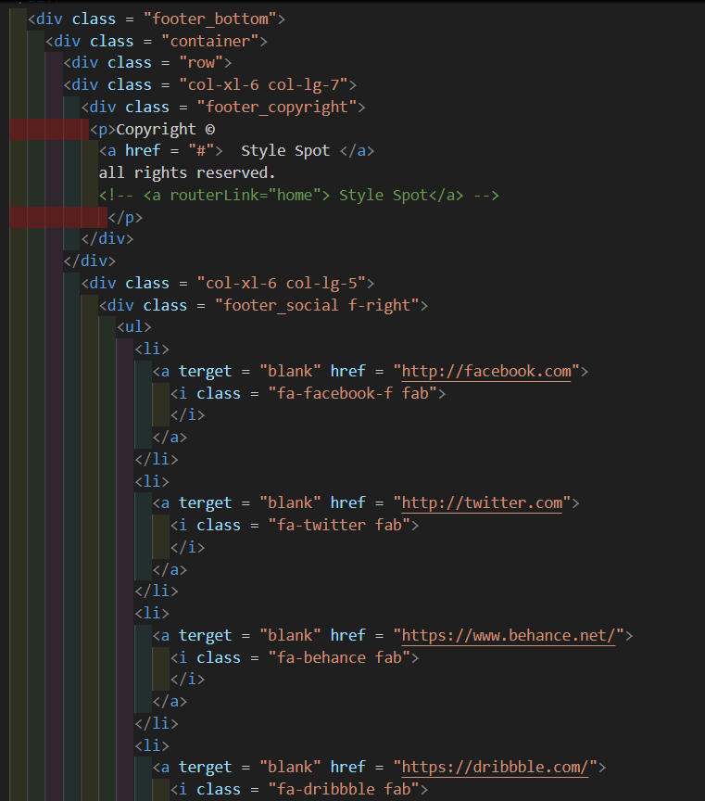
CODE
Page 14

Slide 20
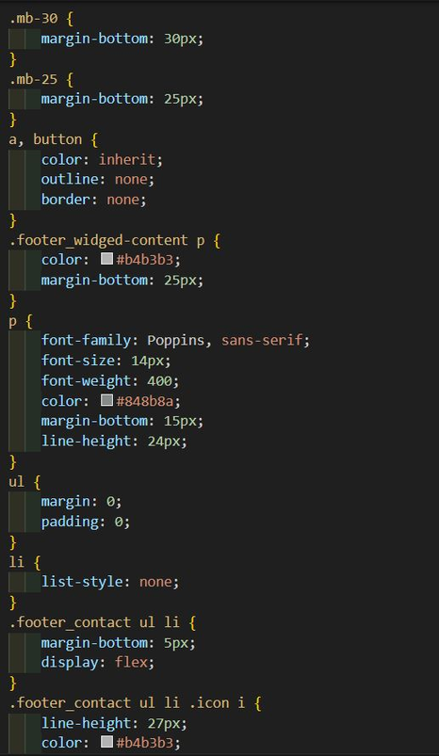
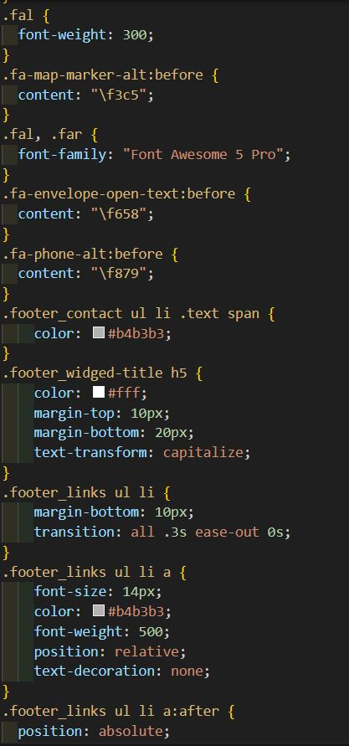
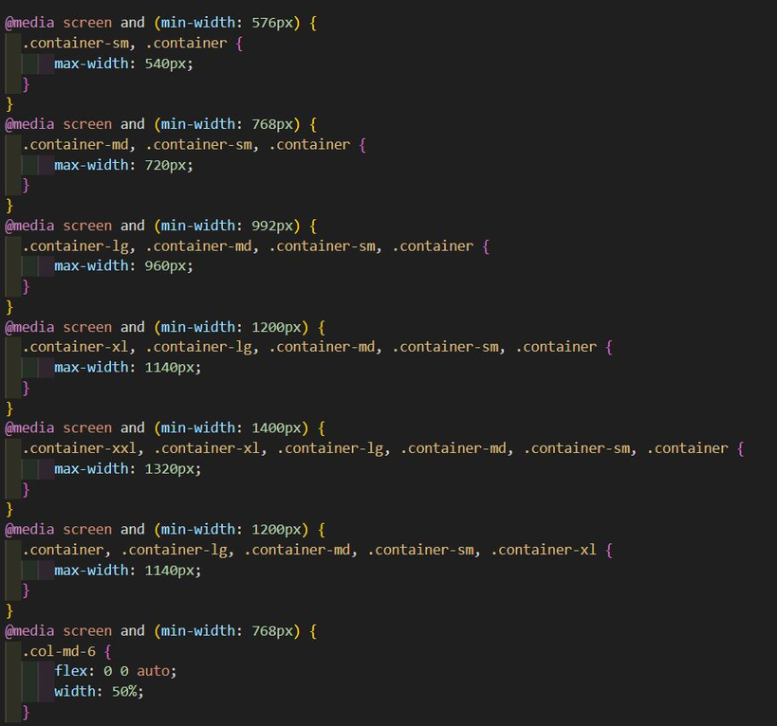
CODE
Page 15

Slide 21
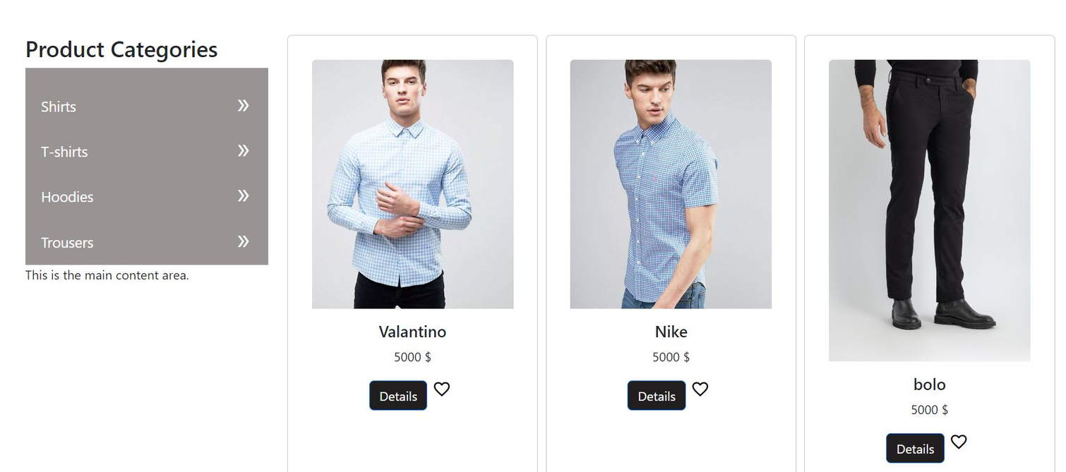
Page 16
SHOP PAGE
Product Grid: A responsive layout displaying product cards with images, names, prices.
Product Categories List: Contain Categories of products.

Slide 22
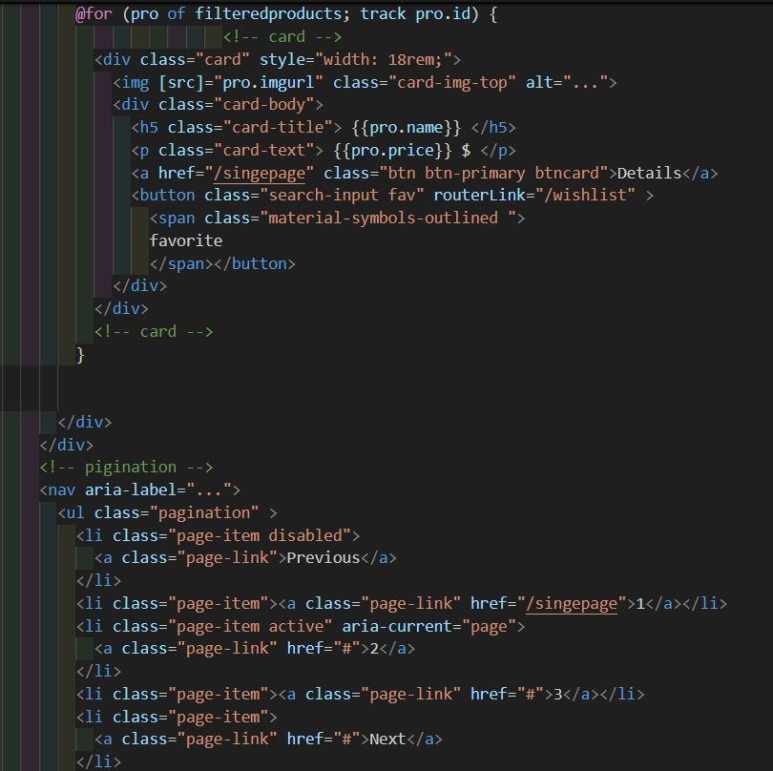
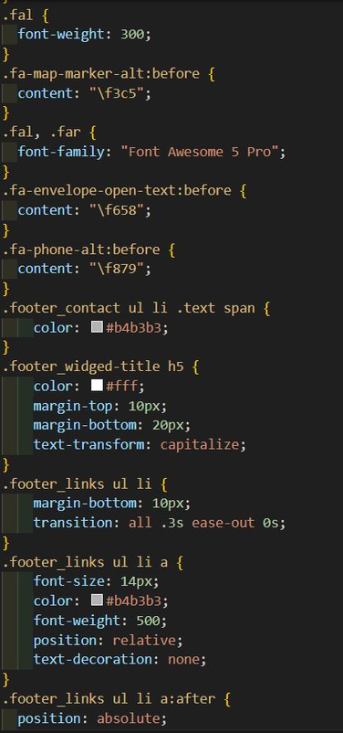
CODE
Page 17

Slide 23
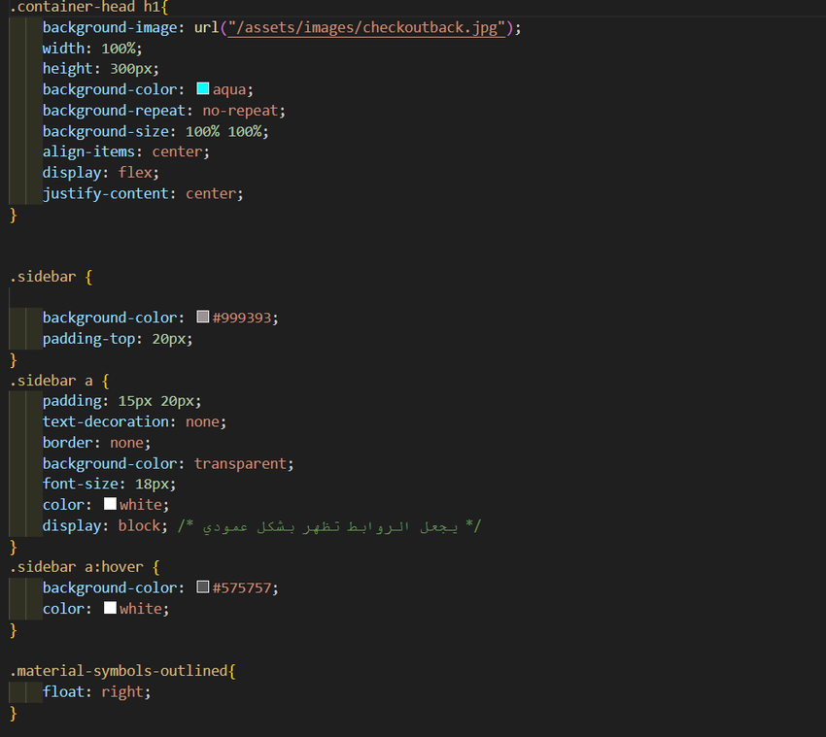
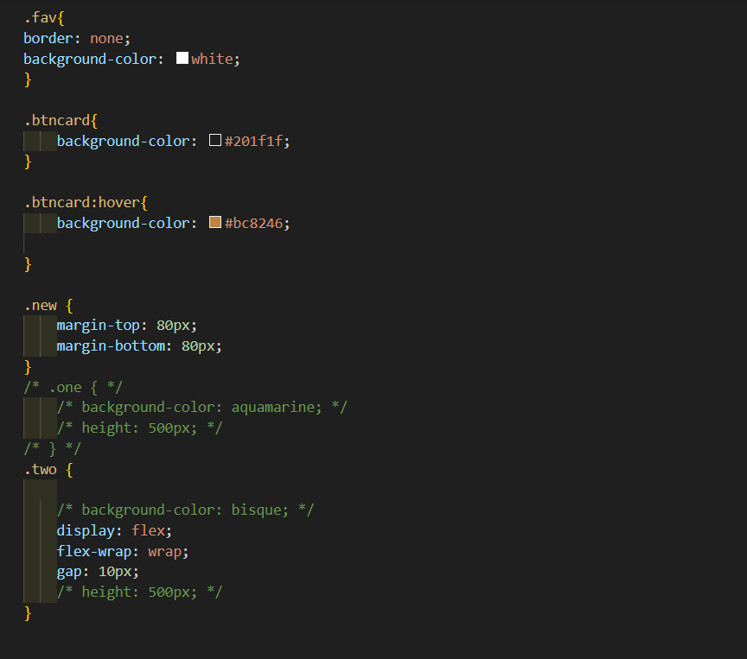
Page 18
CODE

Slide 24
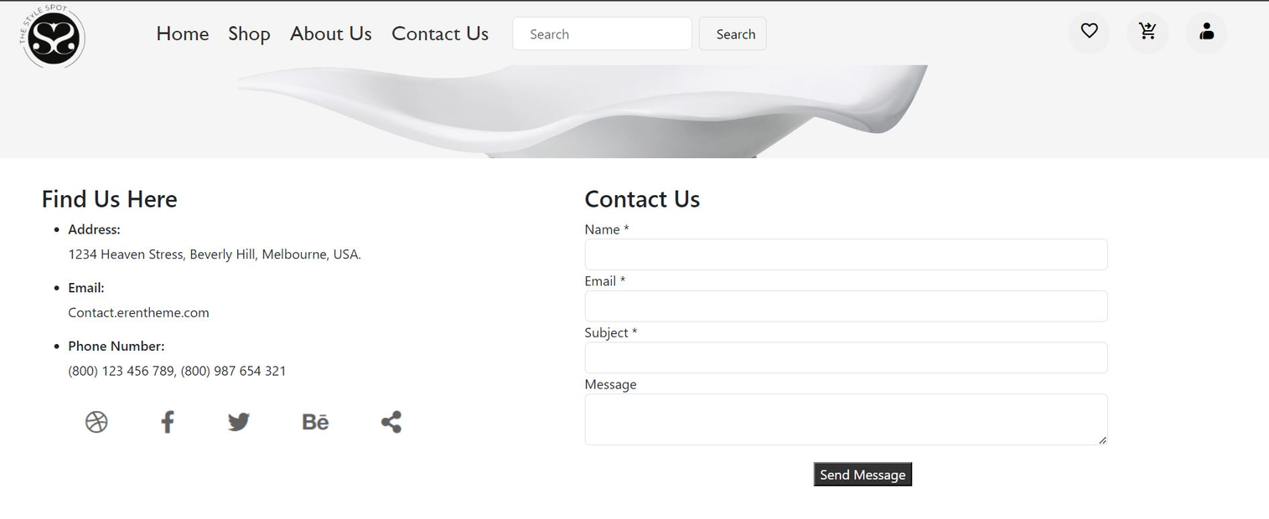
CONTACT US PAGE
Contact Form: A simple form for users to reach out with fields for the name, email, subject, and message.
Contact Information: Clearly displayed phone number, email address, and address for the physical store.
Page 19

Slide 25
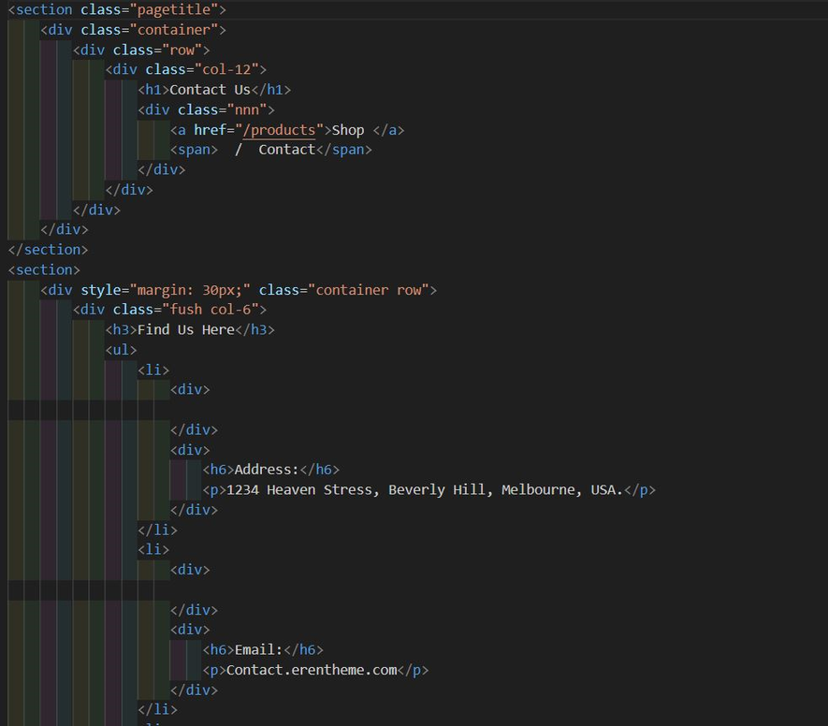
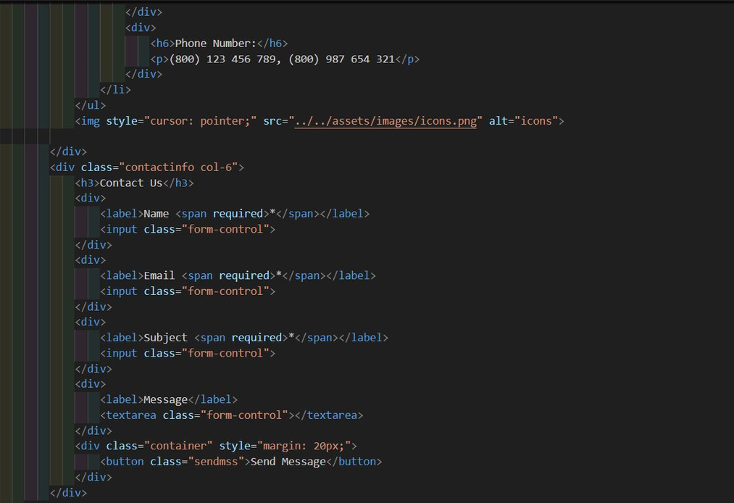
CODE
Page 20

Slide 26
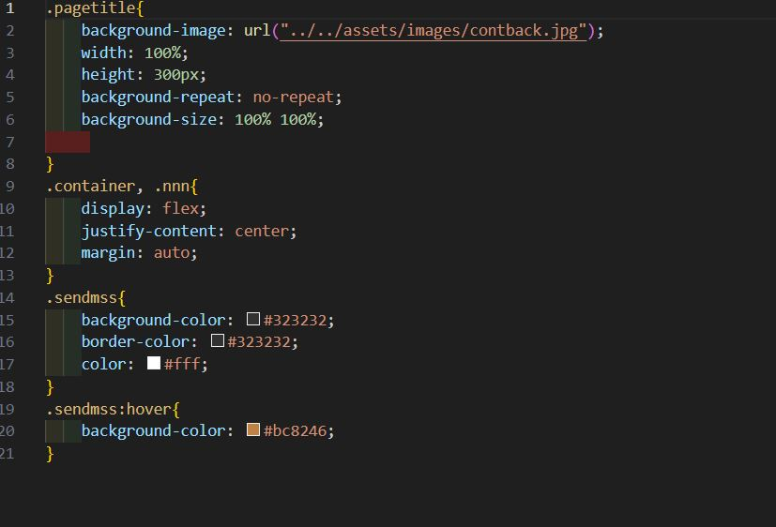
CODE
Page 21

Slide 27

Page 22
FUTURE PROSPECTS
Build platforms that facilitate remote teamwork, integrating features like real-time editing, video conferencing, and project management.

Slide 28

ABOUT
OUR TEAM
Aya Sobhy Hamed Ahmed Haggag.
Hagar Abd El Rahman Murad.
Mahmoud Ramadan Mohammed Ibrahim
Mohamed Abdallah Mansour
Ahmed Essam Hassan
Page 23

Slide 29
THANKS

